Slide 1


Numeric and conversion
Validation Test Team
Dao Xuan Truong
01/2021

Slide 2

Agenda
01
Numeral Systems
02
Number Base Conversion
03
Numeral System in IT

Slide 3
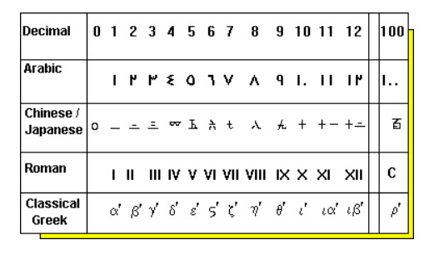
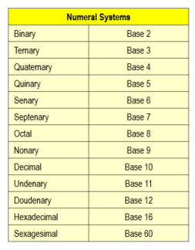
I. Numeral Systems – Define
Numeral systems are a group of rules, norms and conventions that allow us to make a representation of all natural numbers, through a wide group of basic symbols that is defined by the base it uses.
1 / 9

Slide 4
I. Numeral Systems - Common numeral Systems
The other most common numeral systems are binary, decimal, hexadecimal
Numeral Systems
Binary (Base 2)
Decimal (Base 10)
Hexadecimal(Base 16)
- Uses digits: 0 & 1
- Example: 10011011
Uses digits 0 - 9
Example: 5940264
- Uses digits 0-9, Alphabets: A-F (equal 10-15 in decimal)
- Example: 5F8BC6E
Computers can’t count in decimal
Their circuits can only represent one of two states: ON or OFF → makes them a natural fit for binary, which has two states: one and zero
The most familiar for human operators, and it’s shared by almost every culture on Earth.
Make it the standard counting scheme for human communication
A convenient way to represent binary values for human operators
It’s easier to read than a string of ones and zeros
A5FC89: Binary, Decimal, Hexadecimal ?
8451001: Binary, Decimal, Hexadecimal ?
1001011: Binary, Decimal, Hexadecimal ?
2 / 9
Notes:
The binary numeral system, or base-2 number system, represents numeric values using two symbols: 0 and 1. More specifically, the usual base-2 system is a positional notation with a radix of 2. Because of its straightforward implementation in digital electronic circuitry using logic gates, the binary system is used internally by almost all modern computers.

Slide 5

II. Number Base Conversion
Decimal
Binary
Hexadecimal
Decimal | Binary | Hexadecimal
0 | 0000 | 0
1 | 0001 | 1
2 | 0010 | 2
3 | 0011 | 3
4 | 0100 | 4
5 | 0101 | 5
6 | 0110 | 6
7 | 0111 | 7
8 | 1000 | 8
9 | 1001 | 9
10 | 1010 | A
11 | 1011 | B
12 | 1100 | C
13 | 1101 | D
14 | 1110 | E
15 | 1111 | F
3 / 9

Slide 6
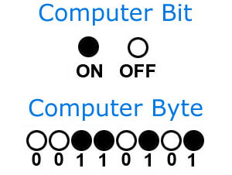
III. Numeral System in IT - Bit and Byte
Historical
- Computers operate by using millions of electronic switches (transistors), each of which is either on or off (similar to a light switch, but much smaller). Computer does not have many states to store information, therefore, it stores information based on the two states of ON and OFF (1 and 0 respectively).
The byte was the number of bits used to encode a single character of text in a computer
Some computers use 6 bits to represent characters
ANSI is inheritance of the ASCII code table defined a 8-bit character set
5
bits
7
bits
At the beginning of computer age people have used baudot as a basic unit
6
bits
ASCII defined a 7-bit character set
8
bits
Bit (Binary Digit)
Bit is the smallest unit of information that can be stored.
It consists of either zero or one.
Byte
The byte is a unit of digital information that most commonly consists of eight bits
- Example: 01000001
4 / 9
Notes:
- Computers operate by using millions of electronic switches (transistors), each of which is either on or off (similar to a light switch, but much smaller). The state of the switch (either on or off) can represent binary information, such as yes or no, true or false, 1 or 0. The basic unit of information in a computer is thus the binary digit (BIT). Although computers can represent an incredible variety of information, every representation must finally be reduced to on and off states of a transistor.
- At the beginning of computer age people have used baudot as a basic unit, which is equivalent to 5 bits, i.e. it can represent numbers from 0 to 31. If each number represents a character, 32 is enough to use for the uppercase letters such as A, B, ... Z, and a few more characters. It is not enough for all lowercase characters.
- Immediately after, some computers use 6 bits to represent characters and can represent at maximum 64 characters. They are enough to use for A, B, .. Z, a, b.. Z, 0, 1, 2, .. 9 but not enough for other characters such as +,-,*, / and spaces.Thus, 6 bits quickly become to be restricted.
- ASCII defined a 7-bit character set. That was "good enough" for a lot of uses for a long time, and has formed the basis of most newer character sets as well (ISO 646, ISO 8859, Unicode, ISO 10646, etc.)
- 8-bit, a little bit more than 7-bit which is better. It doesn't cause too large waste. The 8-bit is a collection of numbers between 0 and 255 and it satisfies computer designers. The concept of byte was born, 1 byte = 8 bits.
For 8-bit, Designers can define other characters, including special characters in computer. ANSI code table was born which is inheritance of the ASCII code table:

Slide 7
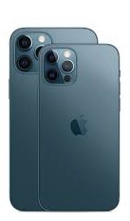

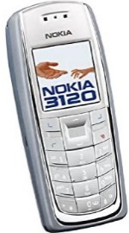

III. Numeral System in IT - Bit and Byte
Bit position
7 | 6 | 5 | 4 | 3 | 2 | 1 | 0
Byte bit position
Word bit position
15 | 14 | 13 | 12 | 11 | 10 | 9 | 8 | 7 | 6 | 5 | 4 | 3 | 2 | 1 | 0
Binary representation
Binary bits | Bytes | Alternatives
8 | 1 | 256
10 |  | 1024
12 |  | 4096
16 | 2 | 65536
20 |  | 1,048,576
24 | 3 | 16,777,741,216
30 |  | 1,073,741,824
32 | 4 | 4,294,967,296
n | [n/8] | 2^{n}
- Numbers are stored on the computer in binary form
- On most computers, the memory is organized into 8-bit bytes. This means each 8-bit byte stored in memory will have a separate address
- Alternatives are defined as the total number of possibilities.
Common unit
No | Unit | Convert
1 | Kb (Kilobits) | 1Kb = 2¹⁰ bit
2 | KB (Kilobytes) | 1KB = 2¹⁰ = 1024 Byte
3 | MB (Megabytes) | 1MB = 2¹⁰ KB = 1024 KB
4 | GB (Gigabytes) | 1GB = 2¹⁰ MB = 1024 MB
5 | TB (Terabytes) | 1TB = 2¹⁰ GB = 1024 GB
5 / 9

Slide 8
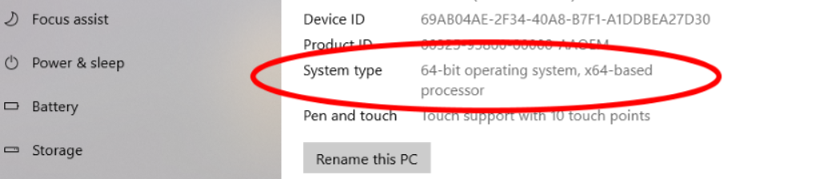
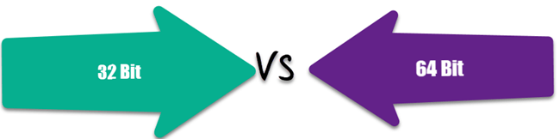
III. Numeral System in IT - Win32 and Win64
A processor or CPU includes registers and logic circuits. Also called the brain of the computer. The size of the CPU register is 32-bit in a 32-bit CPU and similar for 64-bit.
Parameter | 32-bit processors | 64-bit processors
Hardware | A 32-bit system consists of a 32-bit register. Capable of storing 232 or 4,294,967,296 values. A 32-bit system can address up to 4GB of RAM. The actual can be thought of as 3.5 GB. This is because a part of registry stores temporary values with the memory addresses. | A 64-bit system consists of 64-bit register Capable of holding 264 or 18,446,744,073,709,551,616 values. A 64-bit register has the capability of addressing around 16 exabytes of memory. It can clearly access more than 4GB of RAM.
Software | Only competitive 32-bit programs | Competitive 32-bit and 64-bit programs
6 / 9

Slide 9
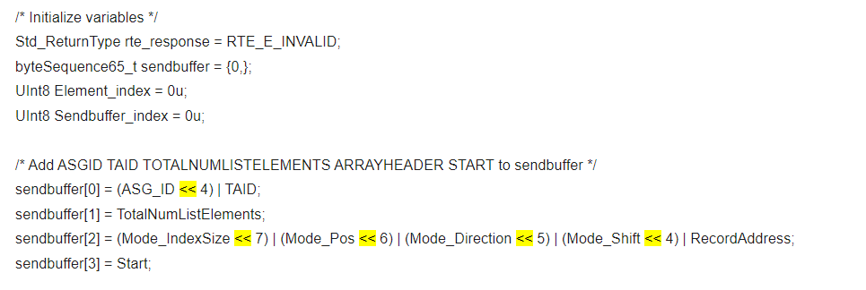
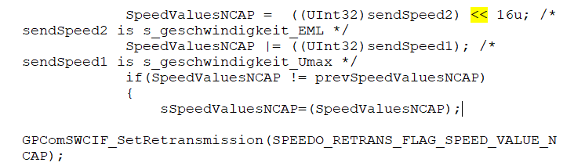
III. Numeral System in IT – Shifting
SyRS
Coding
7 / 9

Slide 10
III. Numeral System in IT – Shifting
A bit shift moves each digit in a number's binary representation left or right
Left Shift
- When shifting left, the most-significant bit is lost, and a 00 bit is inserted on the other end.
- The left shift operator is usually written as "<<".
Example: Left shift 2 positions – 10001101 << 2 → ?
Before
1 0 0 0 1 1 0 1
10001101 << 2 → 00110100
After
0 0 1 1 0 1 0 0
Right Shift
- When shifting right, the least-significant bit is lost and a 0 is inserted on the other end.
- The right shift operator is usually written as “>>".
Example: Right shift 3 positions - 10010011 >> 3 → ?
Before
1 0 0 1 0 0 1 1
10010011 >> 3 → 00010010
After
0 0 0 1 0 0 1 0
8 / 9

Slide 11

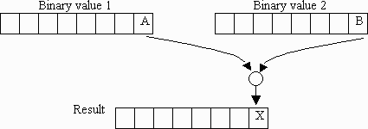
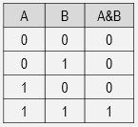
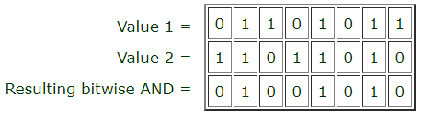
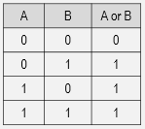
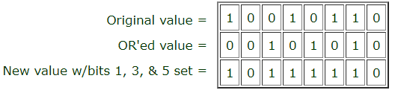
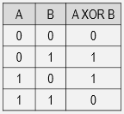
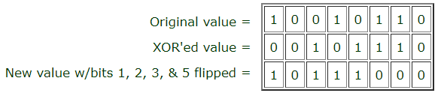
III. Numeric System in IT – Bitwise Operations
Item | Purpose | Define | Example
AND | Clearing Bits
OR | Setting Bits
XOR | Toggling Bits
9 / 9

Slide 12
Thank you

Slide 13
Q&A

Slide 14
II. Number Base Conversion - Decimal to Binary and Hexadecimal
How to convert
Divide the number by 2 (Binary) or 16 (Hexadecimal)
Get the integer quotient for the next iteration.
Get the remainder for the binary/Hexadecimal digit.
Repeat the steps until the quotient is equal to 0, getting remainders from bottom to top
Example
Decimal to Binary
Decimal to Hexadecimal
(10)₁₀ = (?)₂
(41719)₁₀ = (?)₁₆
10
2
0
5
2
41719
16
2
2
7
2607
16
16
1
2
15
162
0
1
10
16
1
0
2
0
10
(10)₁₀ = (1010)₂
(41719)₁₀ = (A2F7)₁₆
A.1 / 10

Slide 15
II. Number Base Conversion - Binary to Decimal
How to convert
Write down the powers of 2.
Under each power of two result, write the corresponding bit value
Multiply each bit value with the corresponding power of 2 and add the products together
The result of the sum is the decimal number
Example
(1010)₂ = (10)₁₀
(1010)₂ = (?)₁₀
STEP 1
2³ 2² 2¹ 2⁰
STEP 2
1 | 0 | 1 | 0
0.2⁰
1.2¹
STEP 3
0.2²
1.2³
STEP 4
(1010)₂ = (1.2³ + 0.2² + 1.2¹ + 0.2⁰)₁₀
= (10)₁₀
A.2 / 10

Slide 16
II. Number Base Conversion - Hexadecimal to Decimal
How to convert
Write down the powers of 16.
Under each power of 16 result, write the corresponding bit value
Multiply each value with the corresponding power of 16 and add the products together
The result of the sum is the decimal number
Example
(A2F7)₁₆ = (?)₁₀
(A2F7)₁₆ = (?)₁₀
STEP 1
16³ 16² 16¹ 16⁰
STEP 2
A | 2 | F | 7
7.16⁰
F.16¹
STEP 3
2.16²
A.16³
(A2F7)₁₆ = (A.16³ + 2.16² + F.16¹ + 7.16⁰)₁₀
= (10.16³ + 2.16² + 15.16¹ + 7.16⁰)₁₀
= (41719)₁₀
STEP 4
A.3 / 10

Slide 17
II. Number Base Conversion - Binary to Hexadecimal
How to convert
Write down the binary number and group the digits (0’s and 1’s) in sets of four.
Write 8, 4, 2 and 1 below each group.
Multiply the 8, 4, 2 and 1’s by the digit above.
Add the products within each set of four.
The digits you get from the sums in each group will give you the hexadecimal number, from left to right
Example
(10101101)₂ = (?)₁₆
(10101101)₂ = (AD)₁₆
 | 1010 | 1101
 | 8 4 2 1 | 8 4 2 1
 | 8 0 2 0 | 8 4 0 1
 | 10 (10 = 8+2) | 13 (13 = 8+4+1)
 | A | D
STEP 1
STEP 2
STEP 3
STEP 4
STEP 5
A.4 / 10
Notes:
Write down the binary number and group the digits (0’s and 1’s) in sets of four. Start doing this from the right. If the leftmost group doesn’t have enough digits to make up a set of four, add extra 0’s to make a group.
Write 8, 4, 2 and 1 below each group. These are the weights of the positions or place holders in the number (23, 22, 21 and 20).
Every group of four in binary will give you one digit in hexadecimal. Multiply the 8, 4, 2 and 1’s by the digit above.
Add the products within each set of four. Write the sums below the groups they belong to.
The digits you get from the sums in each group will give you the hexadecimal number, from left to right.

Slide 18
II. Number Base Conversion - Hexadecimal to Binary
How to convert
Write down the hex number. If there are any, change the hex values represented by letters to their decimal equivalents.
Each hex digit represents four binary digits and therefore is equal to a power of 2.
Determine which powers of two (8, 4, 2 or 1) sum up to your hex digits
Write down 1 below those 8, 4, 2 and 1’s that are used. Write down 0 below those that are not used.
Read the 1’s and 0’s from left to right to get the binary equivalent of the given hex number.
Example
(4FA)₁₆ = (?)₂
(4FA)₁₆ = (10011111010)₂
STEP 1
 | 4 | F | A
 | 4 | 15 | 10
 | 8 4 2 1 | 8 4 2 1 | 8 4 2 1
 | 8 4 2 1 | 8 4 2 1 | 8 4 2 1
 | (4 = 4) | (15 = 8+4+2+1) | (10 = 8+2)
 | 0100 | 1111 | 1010
 | (4FA)₁₆ = (10011111010)₂
STEP 2
STEP 3
STEP 4
STEP 5
A.5 / 10
Notes:
Write down the hex number. If there are any, change the hex values represented by letters to their decimal equivalents.
Each hex digit represents four binary digits and therefore is equal to a power of 2. The rightmost digit equals to 20 (1), the next one equals to 21 (2), the next one equals to 22 (4) and the leftmost one equals to 23 (8). Write these numbers (8, 4, 2 and 1) below the hex values.
Determine which powers of two (8, 4, 2 or 1) sum up to your hex digits. For example, if one of your hex values is 10, this means 8 and 2 sum up to 10 (4 and 1 are not used). If your hex number is 2, only 2 is used; 8, 4 and 1 are not.
Write down 1 below those 8, 4, 2 and 1’s that are used. Write down 0 below those that are not used.
Read the 1’s and 0’s from left to right to get the binary equivalent of the given hex number.

Slide 19
II. Number Base Conversion - Enhance
Fractional Number
Decimal | Binary | Hexadecimal
0.71875 (1.2⁻¹ + 0.2⁻² + 1.2⁻³ + 1.2⁻⁴ + 1.2⁻⁵ ) | 0.10111 | 0.B8 (0.10101000)
0.1012625 (1.16⁻¹ + A.16⁻² ) | 0.0001101 (0.00011010) | 0.1A
0.75 | 0.11 (0.75x2= 1.5 → 0.5x2= 1.0→0x2 = 0.0) | 0.C 0.75x16 = 12.0 → 0x16 = 0.0
A.6 / 10

Slide 20
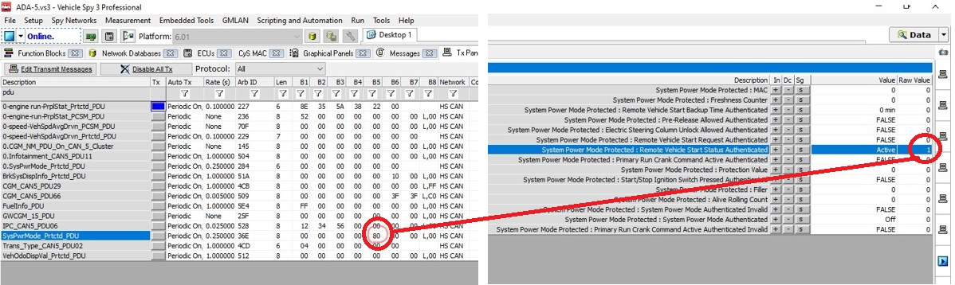
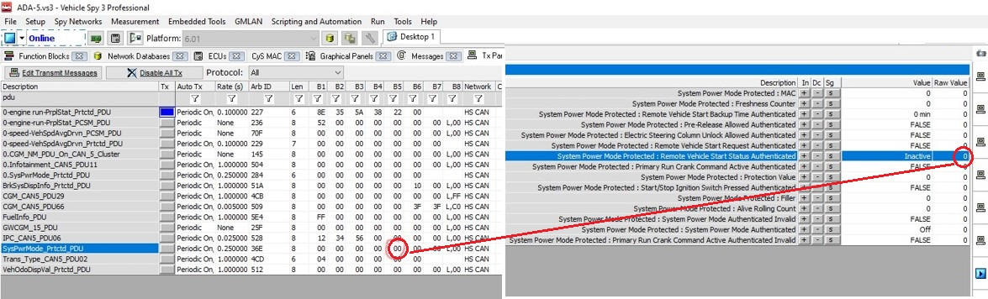
A1. Relationship between bit-byte
A.7 / 10

Slide 21
A2. Practice Convert Binary To Hexadecimal
Case 1: (11001011)₂ = (?)₁₆
Binary
1 | 1 | 0 | 1 | 0 | 1 | 0 | 1
1101 → 8+4+0+1 = 13 → D
0101 → 0+4+0+1 = 5 → 5
D | 5
Hexadecimal
(11001011)₂ = (D5)₁₆
Case 2: (11100110)₂ = (?)₁₆
Binary
1 | 1 | 0 | 0 | 0 | 0 | 1 | 0
C | 2
Hexadecimal
(11100110)₂ = (C2)₁₆
A.8 / 10

Slide 22
A3. Practice Convert Hexadecimal To Binary
Case 1: (2A)₁₆ = (?)₂
Binary
0 | 0 | 1 | 0 | 1 | 0 | 1 | 0
2 → 2 → 0+0+2+ 0 → 0010
A →10 → 8+0+2+0 → 1010
2 | A
Hexadecimal
(2A)₁₆ = (00101010)₂
Case 2: (E7)₁₆ = (?)₂
Binary
1 | 1 | 1 | 0 | 0 | 1 | 1 | 1
E | 7
Hexadecimal
(E7)₁₆ = (11100111)₂
A.9 / 10

Slide 23
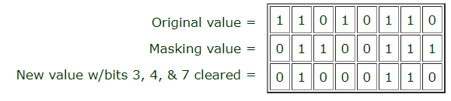
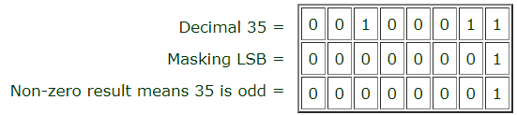
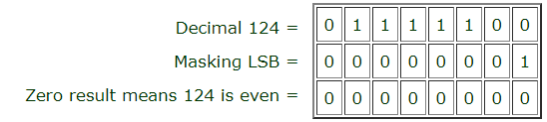
A4. AND example
Clearing bits
Check odd/even number
A.10 / 10

